Slide 1
Intercultural research and motor insurance premium rates: prejudices, multi-dimensional criteria and global trends
Michael Fackler, independent consulting actuary
May 11th – May 15th 2020

Slide 2
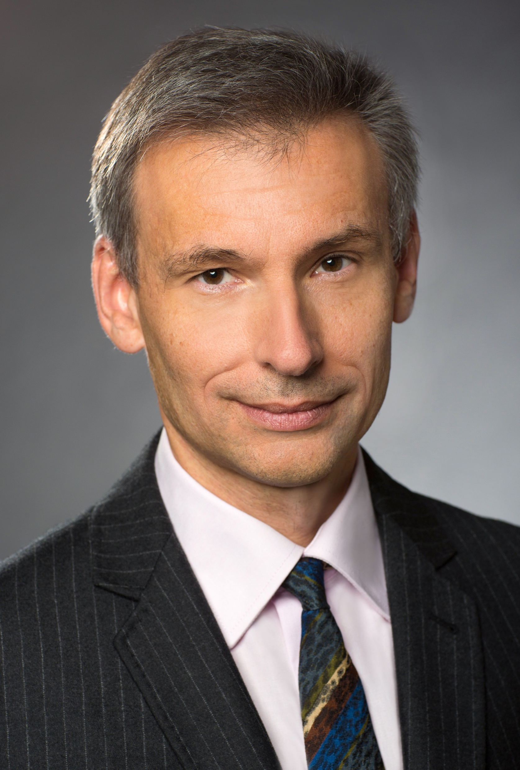
About the speaker
Dr. Michael Fackler
Fellow DAV, 25 years in (re)insurance
Univ. at Munich & Pisa: Math, Physics & a bit more
Lately: doctorate at Oldenburg on experience rating
independent consulting actuary
Main areas: non-life reinsurance pricing, dealing with scarce data
Seminars, talks, papers

Slide 3
Intercultural research, old style: Greeks about Romans, ca. 100 BC
Polybius:
At Rome, nothing is considered more disgraceful than to accept bribes and seek gain from improper channels.
Among the Romans their magistrates handle large sums of money and scrupulously perform their duty just because they have given their word on oath.
Among the Greeks men who hold public office cannot be trusted with the safekeeping of so much as a single talent, even if they have ten accountants and as many seals and twice as many witnesses.

Slide 4
Intercultural research, old style: Greeks about others, ca. 100 BC
Polybius:
At Carthage candidates for office practise open bribery, whereas at Rome death is the penalty for it.
Diodorus Siculus:
The Gauls converse with few words and in riddles, hinting darkly at things for the most part and using one word when they mean another.
Posidonius:
The Germans eat meat roasted in joints for luncheon and drink milk.

Slide 5
The cultural diversity challenge
Diversity is interesting, but can be hard work.
Don’t see your culture as the norm.
Not all behaviours we don’t understand are bad.
Not all our achievements are due to our culture.
Example of a premature judgment:
Can a specific Icelandic organizational culture explain the success of Icelandic businesses in foreign expansion?
(2007 paper, published 1 year before Iceland’s banks collapsed)

Slide 6
Intercultural research, modern style: Cultural Dimensions
Hofstede:
Masculinity / femininity
Collectivism / individualism
Power distance high / low
Uncertainty avoidance / tolerance
Trompenaars & al.:
Particularism / universalism
Status through ascription / achievement

Slide 7
Intercultural research, modern style: Method
Survey (many) people about how they would feel and act in a (large) number of given situations
Control for criteria like age, social status, etc.
Analyse dataset via factor analysis
Give the resulting factors (dimensions) an intuitive meaning by assigning attitudes etc.

Slide 8
Interpreting multidimensional statistics
Motor insurance example:
Observation: Garage owners cause less accidents than others.
Objection: How come does the garage matter?
Interpretation: It does not, but indicates lifestyle (prudence).
Action: Premium discount for garage owners
The garage is a proxy for lifestyle: objective, controllable – and applicable in the tariff no matter whether the above interpretation is correct.

Slide 9
Common pitfalls of motor rating and intercultural research
Too many criteria, random effects in small subgroups
Need for interpretation of the results, suspicion of subjectivity
Hidden data errors
People provide positively skewed information
Cultural research is much harder:
you have to ask people about their lifestyle,
you must publish your interpretations.
Not surprisingly, there is a lot of debate on the results.

Slide 10
How can actuaries use cultural dimensions?
Proposal: follow George Box
Essentially, all models are wrong, but some are useful.
Use with pragmatism, like a GLM pricing output.
Such empirical output …
is likely useful,
enables you possibly to make predictions,
hints possibly at causalities etc.,
is provisional knowledge, likely to evolve with new/better data.

Slide 11
Conclusion
Knowledge of cultural dimensions helps in all kinds of international interaction.
Further it sheds light on a number of interesting questions:
Is the Roman Empire still there?
Can tribal cultures operate nuclear power plants?
How should international companies/associations deal with cultural differences?
…

Slide 12
Thank you for your attention
Contact details :
Michael Fackler
Munich,
Germany
michael_fackler@web.de
For the paper
see IAA website or
https://www.institutdesactuaires.com/

Slide 13
Disclaimer:
The views or opinions expressed in this presentation are those of the authors and do not necessarily reflect official policies or positions of the Institut des Actuaires (IA), the International Actuarial Association (IAA) and its Sections.
While every effort has been made to ensure the accuracy and completeness of the material, the IA, IAA and authors give no warranty in that regard and reject any responsibility or liability for any loss or damage incurred through the use of, or reliance upon, the information contained therein. Reproduction and translations are permitted with mention of the source.
Permission is granted to make brief excerpts of the presentation for a published review. Permission is also granted to make limited numbers of copies of items in this presentation for personal, internal, classroom or other instructional use, on condition that the foregoing copyright notice is used so as to give reasonable notice of the author, the IA and the IAA's copyrights. This consent for free limited copying without prior consent of the author, IA or the IAA does not extend to making copies for general distribution, for advertising or promotional purposes, for inclusion in new collective works or for resale.

