Slide 1
AGLM, A Hybrid Modeling Method of GLM and Data Science Techniques
Suguru Fujita, FIAJ, CERA
Toyoto Tanaka, FIAJ Kenji Kondo, FIAJ
Hirokazu Iwasawa, FIAJ
May 11th – May 15th, 2020

Slide 2
About the speaker

Slide 3
Agenda
Introduction
GLM and Regularized GLM
AGLM: Accurate GLM
Advantages of AGLM
Numerical Experiments
Conclusion

Slide 4
Agenda
Introduction
GLM and Regularized GLM
AGLM: Accurate GLM
Advantages of AGLM
Numerical Experiments
Conclusion

Slide 5
Introduction Our Motivation
Machine Learning Modeling (e.g. GBM, NN, etc.)
High prediction accuracy! ...How about interpretability?
Research on the interpretability has been getting attention recently (e.g. XAI [Gunning 2017])
Actuarial Modeling (e.g. GLM, GAM, etc.)
High interpretability! ...How about prediction accuracy?
A lots of researches on the implementation of ML methods
GBM for pricing [Yang et al. 2018], NN for reserving [Poon et al. 2019]

Slide 6
Introduction Our Motivation
Well-Balanced Model is critical
Examples of previous research
The regularized GLM with different types of regularization term according to the type of features [Devriendt et al. 2018]
A method combining GLM and NN [Wüthrich and Merz 2019]
Our proposed method: AGLM (Accurate GLM)
Hybrid modeling method of GLM and Data Science techniques
Aim to well-balanced model in terms of both interpretability and prediction accuracy

Slide 7
Agenda
Introduction
GLM and Regularized GLM
AGLM: Accurate GLM
Advantages of AGLM
Numerical Experiments
Conclusion

Slide 8
GLM and Regularized GLM GLM
GLM: Generalized Linear Model
Estimation method of $β$ – MLE
$$E[y_{i}]={g_{}^{−1}(β}_{0}+β_{1}x_{i1}+⋯+β_{p}x_{ip}) (i=1,2,⋯,n)$$
Notation -
$$\hat{β}=\underset{β}{argmin}{\{−logL\left(β\right)\}}$$
$$y$$ | Response variable
$$x$$ | Features (explanatory variables)
$$β$$ | Regression coefficients
$$n$$ | # observations
$$p$$ | # features
$$g$$ | Link function
$$L$$ | Likelihood function
KEY POINT💡
GLM has high interpretability!
Relationship between $y$ and $x$ is clear!

Slide 9
GLM and Regularized GLM Regularization
If you apply Regularization, you can...
Achieve feature selection;
Avoid overfitting;
Avoid the instability of calculation due to multicollinearity;
Deal with ill-conditioned problems ($p>n$)

Slide 10
GLM and Regularized GLM Regularized GLM
MLE to be changed
Typical Regularization terms
$$\hat{β}=\underset{β}{argmin}{\{−logL\left(β\right)+R(β;λ)\}\}}$$
Ridge (L2) | $$R(β;λ)=λ\sum_{j=1}^{p}{{\left|β_{j}\right|}^{2}}$$
Lasso (L1) | $$R(β;λ)=λ\sum_{j=1}^{p}{\left|β_{j}\right|}$$
Elastic Net | $$R(β;λ,α)=λ\left\{(1−α)\sum_{j=1}^{p}{\left|β_{j}\right|}+α\sum_{j=1}^{p}{{\left|β_{j}\right|}^{2}}\right\}$$
Feature Selection
Effect (L1 norm)

Slide 11
Agenda
Introduction
GLM and Regularized GLM
AGLM: Accurate GLM
Advantages of AGLM
Numerical Experiments
Conclusion

Slide 12
AGLM: Accurate GLM
To Begin with..

Slide 13
AGLM: Accurate GLM Definition
AGLM consists of three techniques:
What does ‘A’ stand for?
“Accurate” - we expect to achieve higher prediction accuracy than normal GLM
Actually see it as a somewhat symbolic letter representing other words, such as “Actuarial,” “Accountable,” etc.
DONE
Regularized GLM
Discretization
O Dummy/L Variables
By chance? ☻

Slide 14
AGLM: Accurate GLM
Discretization

Slide 15
AGLM: Accurate GLM Discretization
Split numerical features into several bins
Linear Function
Step Function
Wage
Wage
$$B_{1}$$
$$B_{2}$$
$B_{3}$…
10s
20s
30s…
Age
10s
20s
30s…
Age
$$x ⟼ βx$$
$$x ⟼ \sum_{j}{β_{j}𝕀_{B_{j}}(x)}$$

Slide 16
AGLM: Accurate GLM Discretization
The benefit of Discretization
-> How should we decide # bins?
-> Too small bins might cause overfitting...
Combination with Regularization
You need not to select features ($β_{j}=0$ or not) by trial and error. Regularization can do it automatically
Thus, just split numerical feature as much as possible!
KEY POINT💡
Capture non-linearity and prevent underfitting!
KEY POINT💡
Prevent overfitting as well!

Slide 17
AGLM: Accurate GLM
O Dummy Variables

Slide 18
AGLM: Accurate GLM O Dummy Variables
Concerns need to be solved
The $β$s could change sharply among the adjacent bins;
The sequence of $β$ could lack consistency;
(e.g. $β_{j}=0, but β_{j−1}≠0,β_{j+1}≠0$)
...due to “independent estimation”
Is this permitted?
Premium discount is available in a certain age group, but the nearby groups are not.
KEY POINT💡
Ordinal information is essential!

Slide 19
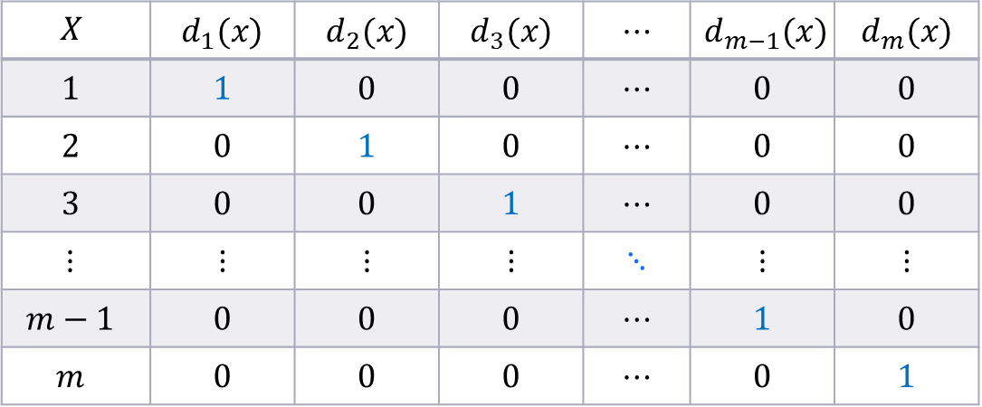
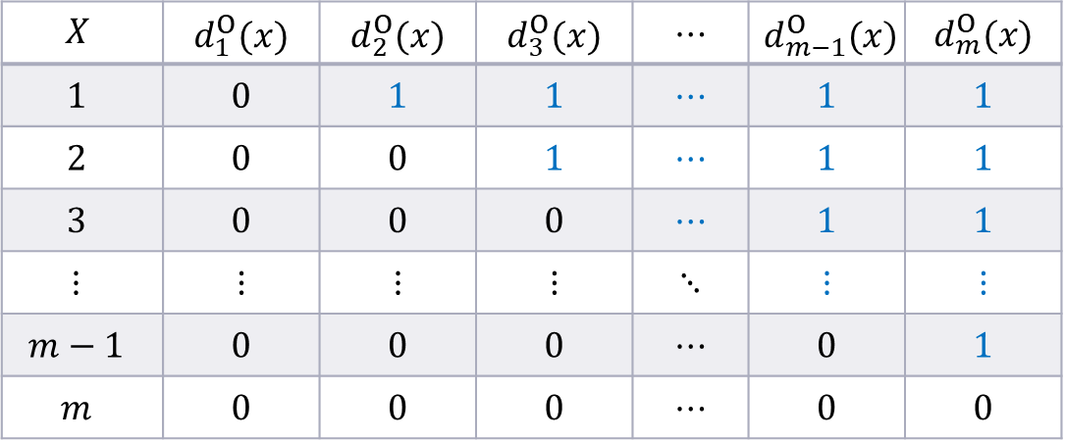
AGLM: Accurate GLM O Dummy Variables
Elaborate on dummy variables
The discretized feature $x$ takes $m$ levels $\left\{1,2,⋯,m\right\} (∋j)$
U (Usual) Dummy
O (Ordinal) Dummy
$$d_{j}(x)=\left\{\begin{aligned}&1 if x=j; \\ &0 otherwise.\end{aligned}\right.$$
$$d_{j}^{O}(x)=\left\{\begin{aligned}&1 if x<j; \\ &0 otherwise.\end{aligned}\right.$$

Slide 20
AGLM: Accurate GLM O Dummy Variables
$β_{j}$ is added up for all $j$ satisfying $j>x$otherwise not
U Dummy Variables
O Dummy Variables
Wage
Wage
…
10s
20s
30s…
Age
10s
20s
30s…
Age
$$x ⟼ \sum_{j}{β_{j} d_{j}(x)}$$
$$x ⟼ \sum_{j}{β_{j}d_{j}^{O}(x)}$$

Slide 21
AGLM: Accurate GLM O Dummy Variables
The benefit of O dummy variables
Combination with regularization
$β_{j}$ represents how much difference to make between the boundary $x<j$ and $x≥j$
It will be determined whether to integrate the adjacent levels or not ($β_{j}=0$ or not)
KEY POINT💡
Relationships between adjacent levels are considered!
KEY POINT💡
Groups are automatically created!

Slide 22
AGLM: Accurate GLM Relationship with Fused Lasso
Fused Lasso
The 1st term: feature selection effect
The 2nd term: grouping effect
AGLM includes Fused Lasso effect
“O dummy” + “L1 regularization” is mathematically equivalent to Fused Lasso
You need not modify the regularization term
$$R\left(β;λ^{\left(1\right)},λ^{\left(2\right)}\right)=λ^{\left(1\right)}\sum_{j=1}^{p}{\left|β_{j}\right|}+λ^{(2)}\sum_{j=2}^{p}{\left|β_{j}−β_{j−1}\right|}$$
KEY POINT💡
AGLM is more flexible!

Slide 23
AGLM: Accurate GLM
L Variables

Slide 24
AGLM: Accurate GLM L Variables
What we want to solve
Step-wise curve is not continuous;
Method that can capture non-linearity more
Further elaborate on numerical features
The discretized feature $x$ takes $m$ levels $\left\{1,2,⋯,m\right\} \left(∋j\right)$
L (Linear) Variables
$$l_{j}(x)=\left\{\begin{aligned}\left|x\&−b_{j}\right| (j=1,…,m−1); \\ &x (j=m).\end{aligned}\right.$$
where $b_{j}$ is
boundary of bin
KEY POINT💡
Focus on slope of each $β_{j}l_{j}(x)$

Slide 25
AGLM: Accurate GLM L Variables
Replace step-wise curve with continuous one
Step Function
Piece-wise Linear Function
Wage
Wage
10s
20s
30s…
Age
10s
20s
30s…
Age
$$x ⟼ \sum_{j}{β_{j} d_{j}(x)}$$
$$x ⟼ \sum_{j}{β_{j}l_{j}(x)}$$

Slide 26
AGLM: Accurate GLM
Summary

Slide 27
AGLM: Accurate GLM Model Formulation
Feature Engineering
Optimization Problem
The same framework as Regularized GLM (w/ Elastic Net)
AS-IS
$$x$$
NUMERIC
Discretization
L VAR
$$l_{j}(x)$$
$$x$$
$$z$$
CATEGORIC
ORDERED
O DUMMY
$$d_{j}^{O}(x)$$
NOT ORDERED
U DUMMY
$$d_{j}(x)$$
Original
Features
NEW
Features
Skip the details ☻

Slide 28
AGLM: Accurate GLM
R Package

Slide 29
AGLM: Accurate GLM R Package ‘aglm’
What is aglm?
A handy R package for AGLM modeling
GitHub - https://github.com/kkondo1981/aglm
What does aglm provide?
Predictive modeling with both accuracy and accountability
Combination of discretization and sparse modeling techniques
GLM-based
Useful functionalities
Simple, easy-to-use R function set similar with glmnet package
Hyper-parameter selections by cross validation
Component + Residual plotting

Slide 30
AGLM: Accurate GLM R Package ‘aglm’
Functions provided by aglm
aglm() – fitting an AGLM model to data
predict() – prediction for new data
cv.aglm(), cva.aglm() – fitting with hyper-parameter selection
plot() – visualizing fitting result
If you are familiar with glmnet package, these functions are really easy and straightforward to use.

Slide 31
AGLM: Accurate GLM R Package ‘aglm’
How does aglm package treat each feature?
As default, aglm package converts input data.frame (or matrix) into internal representations as described above
If you need other kind of treatment, you can specify it directly by using arguments of the aglm() function
Then, internal representations of all the features are combined into one big matrix and passed to glmnet for applying regularized GLM
Feature type | R type | Internal representation
Numeric values | integer, numeric | Combination of Input vector itself O dummy matrix or L variable matrix (optional) interaction matrix of each feature pair
Ordinal factors | ordered | O dummy matrix
Non-ordinal factors | factor | U dummy matrix

Slide 32
Agenda
Introduction
GLM and Regularized GLM
AGLM: Accurate GLM
Advantages of AGLM
Numerical Experiments
Conclusion

Slide 33
Advantages of AGLM Pros of AGLM – it has...
High interpretability as it is based on GLM
Actuaries are familiar with GLM
Clear one-to-one relationship between the response variable $y$ and the features $x$
High prediction accuracy because it avoids both underfitting and overfitting
Even when there are a lot of features and/or complicated non-linearity between the features and the response variable
We expect AGLM to be comparable to GAM, GBM, etc.

Slide 34
Advantages of AGLM Comparison against Other Models
Two angles - interpretability and prediction accuracy
Model | Interpretability (Relative Score) | Prediction Accuracy (Relative Score) | Comments
AGLM | High | High | As mentioned
GLM | High | Low | Clear relationship b/w $y$ and $x$ Manual feature selection needed
Regularized GLM | High | Medium | Clear relationship b/w $y$ and $x$ Need elaboration on non-linearity
GAM | Medium | High | Clear relationship b/w $y$ and $x$ Smoothing can be less interpretable
Tree model (GBM) | Low | High | Not clear relationship b/w $y$ and $x$ Capture non-linearity well
Evaluation reference: (of course, it depends the case)
Interpretability - does the model have clear relationship between response variable and features?
Prediction Accuracy - does the model have a measure against non-linearity?

Slide 35
Agenda
Introduction
GLM and Regularized GLM
AGLM: Accurate GLM
Advantages of AGLM
Numerical Experiments
Conclusion

Slide 36
Numerical experiments Data description
French automobile insurance data
“freMTPL2freq,” CASdatasets package of R [Charpentier 2014]
678,013 records & 12 features
Response variable: ‘ClaimNb’
Offset term: log(‘Exposure’)
Features: Others
Preprocessing:
Discard ‘Idpol’ because it is just for identifications
Censor ‘ClaimNb’ greater than 4, judging they are outliers because policy terms of almost all the policies are one-year or less
This also works for demonstrating ‘aglm’

Slide 37
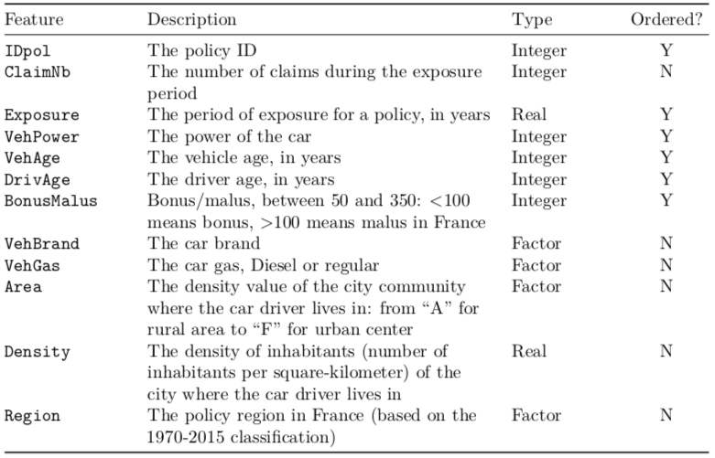
Numerical experiments Data description

Slide 38
Numerical experiments Settings
Compare with five models
We applied Poisson distribution and the log-link function for each modeling method
Holdout - Train : Test = 75% : 25% (of the entire data)
Model | R Package
AGLM | aglm
GLM | glm
Regularized GLM (w/ Elastic Net) | glmnet
GAM | mgcv
GBM | gbm

Slide 39
Numerical experiments Results
Poisson deviance of each model for test data
AGLM is the best among the five models!
AGLM has high prediction accuracy!
Model | Poisson Deviance
AGLM | 0.3111920
GLM | 0.3201199
Regularized GLM (w/ Elastic Net) | 0.3201245
GAM | 0.3171236
GBM | 0.3123919

Slide 40
Numerical experiments Results
Component curves of AGLM
The complicated relationships between the features and the response variable are modeled

Slide 41
Agenda
Introduction
GLM and Regularized GLM
AGLM: Accurate GLM
Advantages of AGLM
Numerical Experiments
Conclusion

Slide 42
Conclusion
AGLM is a well-balanced model
High interpretability - based on GLM
High prediction accuracy – comparable to GAM and GBM
R package ‘aglm’
Provides great functionalities and flexibilities of modeling
Future work – submit to CRAN and expand community!
We believe that this kinds of hybrid modeling methodologies
will get more and more important for actuaries in the future!

Slide 43
Thank you for your attention
Contact details :
Suguru Fujita
Guy Carpenter Japan, Inc.
Midtown Tower 9-7-1 Akasaka
Minatoku, Tokyo 107-6216
Japan
suguru.fujita@guycarp.com
https://www.guycarp.com/
Toyoto Tanaka
Tokio Marine & Nichido Fire Insurance, Co., Ltd.
toyoto.tanaka@tmnf.jp
Kenji Kondo
Tokio Marine & Nichido Life Insurance, Co., Ltd.
kenji.kondou@tmn-anshin.jp
https://github.com/kkondo1981/aglm
Hirokazu Iwasawa
iwahiro@bb.mbn.or.jp

Slide 44
Disclaimer:
The views or opinions expressed in this presentation are those of the authors and do not necessarily reflect official policies or positions of the Institut des Actuaires (IA), the International Actuarial Association (IAA) and its Sections.
While every effort has been made to ensure the accuracy and completeness of the material, the IA, IAA and authors give no warranty in that regard and reject any responsibility or liability for any loss or damage incurred through the use of, or reliance upon, the information contained therein. Reproduction and translations are permitted with mention of the source.
Permission is granted to make brief excerpts of the presentation for a published review. Permission is also granted to make limited numbers of copies of items in this presentation for personal, internal, classroom or other instructional use, on condition that the foregoing copyright notice is used so as to give reasonable notice of the author, the IA and the IAA's copyrights. This consent for free limited copying without prior consent of the author, IA or the IAA does not extend to making copies for general distribution, for advertising or promotional purposes, for inclusion in new collective works or for resale.

